Slide 1
Capstone Project - 1 Hotel Booking Analysis
by-
Team GodSpeed:
Ranjith K
Shreedarsh M Sachin S Panchal Rohan A G Kshipra Parihar

Slide 2
Contents :
Phase 1
Phase 2
Phase 3
1.Data Exploration 2.Data Pre-processing 3.Data Cleaning 4.Type of Hotels 5.Cancellation rate 6.Deposit Policies
Number of Bookings across various factors to observe the trends
1.Top 10countries 2.Meals Preferred 3.Customer Segmentation 4.Average Daily Rate 5.Car parking space 6.Repeated Guests

Slide 3

Hotel Business Industry
The hotel industry is one of the most important components within the service industry, catering for customers who require overnight accommodation. It is closely associated with the travel industry and the hospitality industry, although there are notable differences in scope.
Overall, sales from hotel accounts 87.4% of industry revenue (in India 53.9% and 8% total employment rate)

Slide 4
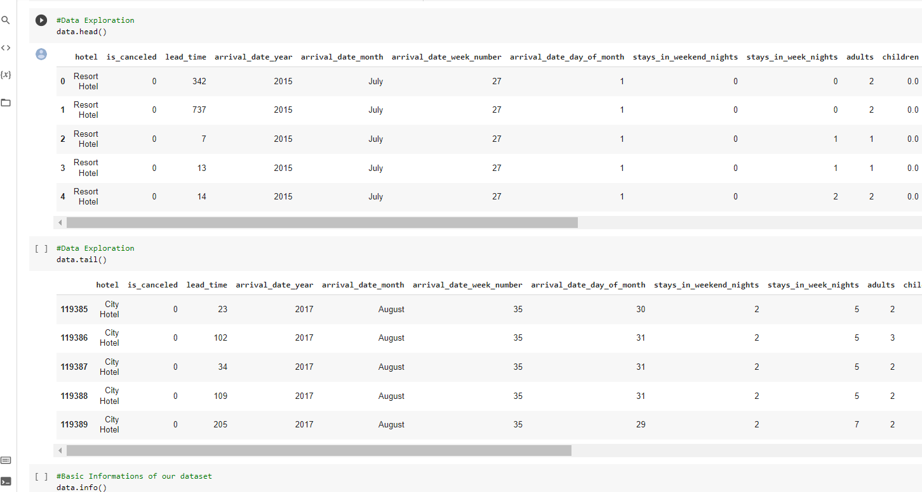
Exploring the dataset

Slide 5
Checking the nullvalues
Replacing the Null Values

Slide 6
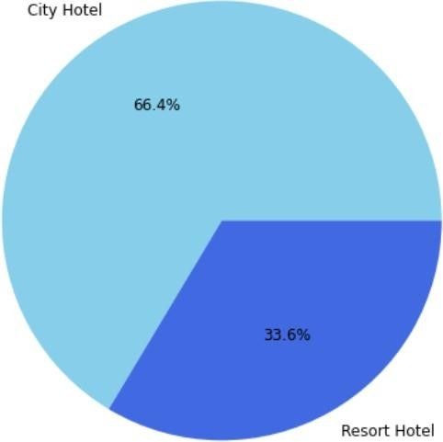
City Hotel and Resort Hotel
It is Observed that City Hotel has more number of bookings compared to Resort Hotel.
The obvious assumption for this trend would be because of monetary reasons.
City hotels would be more affordable than resort hotels due to accessibility, reliability and lavishing factors.

Slide 7
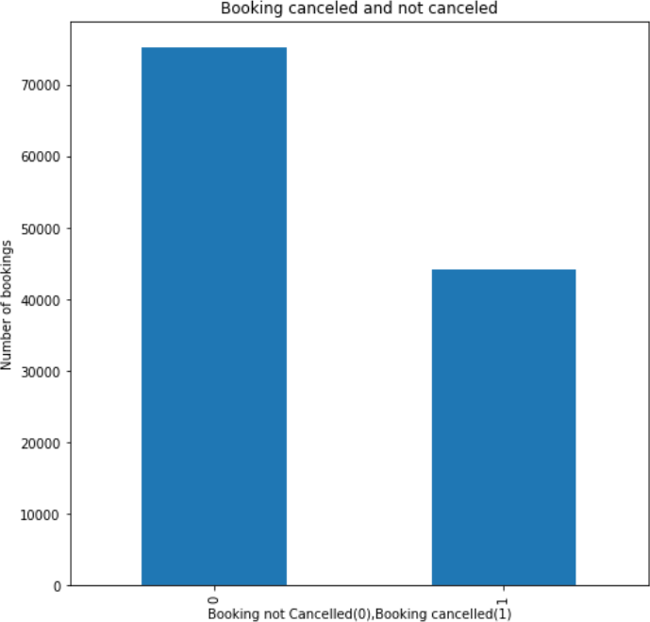
Checked-in and Cancelled Bookings
It is Observed that out of 119390 bookings made, 75166 of them have checked in and 44224 of them has cancelled their bookings.
In percentage, it is about 63% of check-in bookings and 37% of bookings were cancelled.
High cancellation rate will adversely effect the hotel industry which reduces the yield of profit.

Slide 8
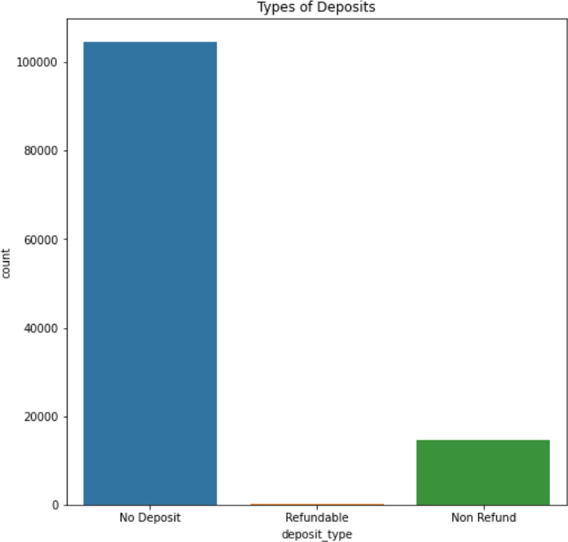
Deposit Policies of Hotel
Most number of the hotel bookings are made in ‘No Deposit, type of transaction which is the reason for the high cancelation rate.
‘No Deposit’ type of transaction means without paying any advance money for thebooking.
In order to reduce cancelation rate, we need to find suitable alternative for the ‘No Deposit’ type of the transation.

Slide 9
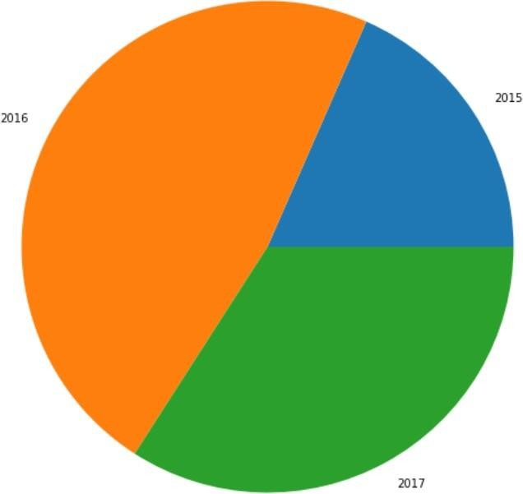
Number of Bookings Across Different Years
Most Number of the bookings are done in the year 2016 following 2017 and 2015 for the dataset given comprising the data for these 3 years.
When, sub plotted, we can see that City hotel has high demand rather than Resort hotels due to its reliability and price difference compared toresort hotels.

Slide 10
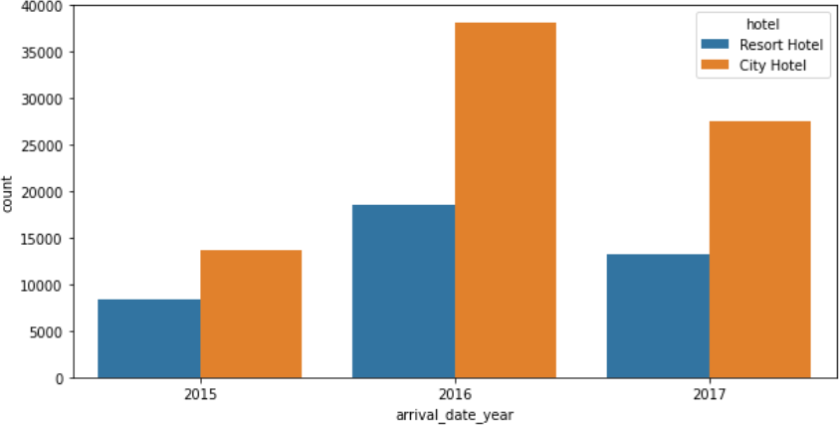
Number of Bookings Across Different Years

Slide 11
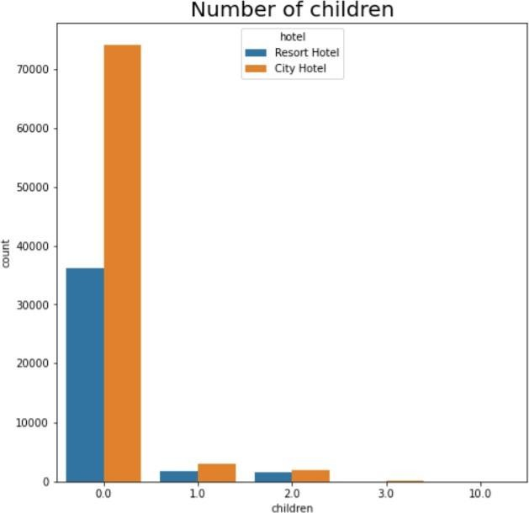
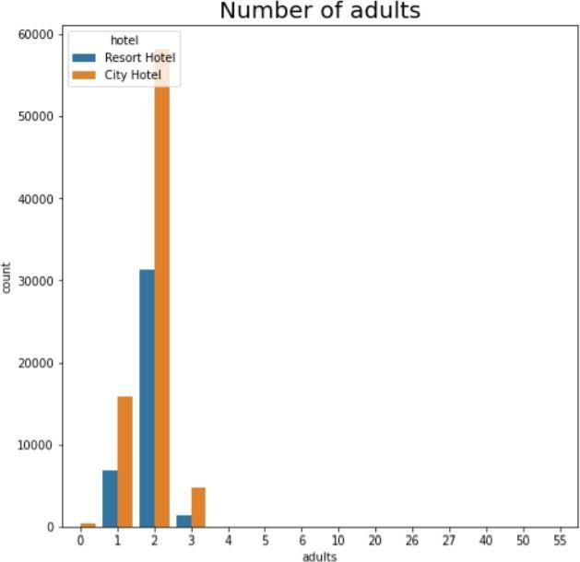
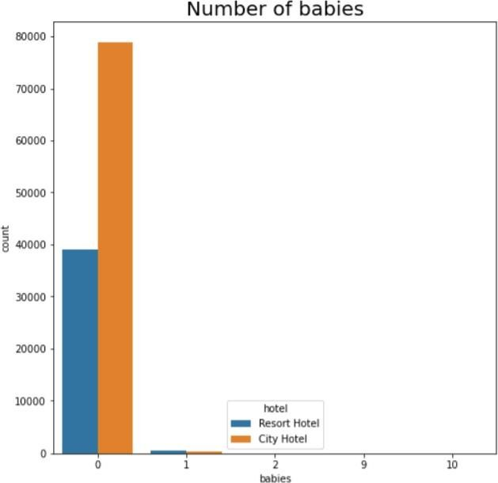
Number of Adults and Children
On an average, two adults checks in at a time. The trend is same for both resort and city
type hotel.
From the graphs above we get the insight that usually customers would be adults, if the children comes along it would be usually one or two.
The count of babies are even less.

Slide 12
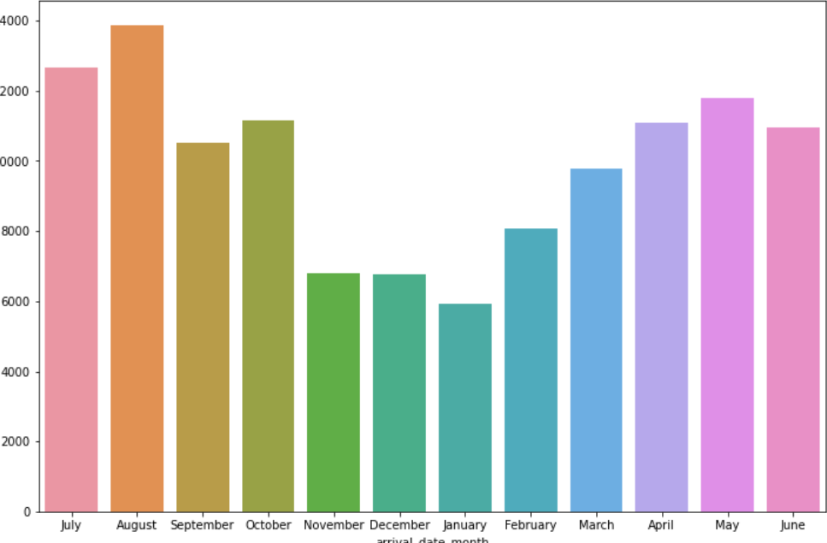
Number of booking done across differentmonths

Slide 13
Number of booking done across differentmonths
From the graph which we have interpreted, we can see that most number of the
bookings are done at month of August, and then July.
Whereas January has the lowest number of bookings.
From Customer point of view, January would be the best month to book a hotel as Average daily rate would be less at this point of time.
We can also assume that most bookings are done during Autumn season due to the ideal weather conditions without much fluctuations.

Slide 14
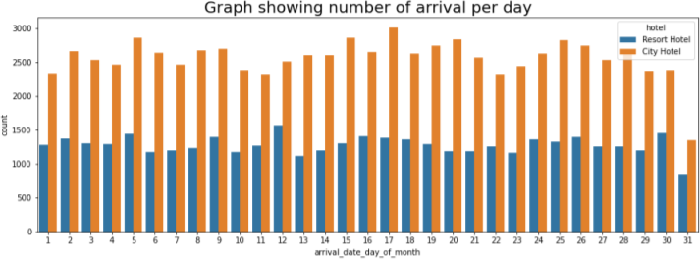
Arrival Per day

Slide 15
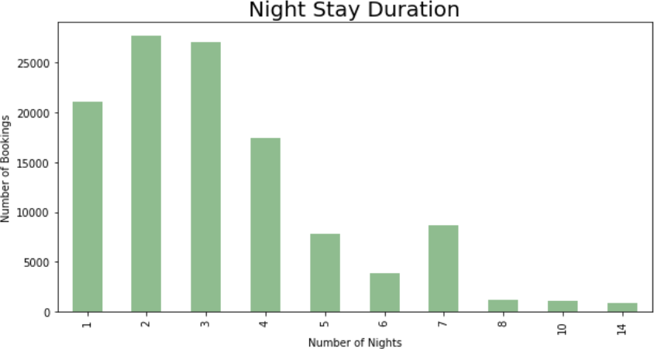
Night Stay Duration

Slide 16
Night Stay Duration
By combining the two columns ‘stay_in_week_nights’ and
‘stay_in_weekend_nights’ we got total number of night stays.
From the graph we can easily interpret that most number of customers prefers to stay for one, two and three days of which most customers prefer for 2 night stays.
Very few number of customers are interested to stay for more than 5 days.

Slide 17
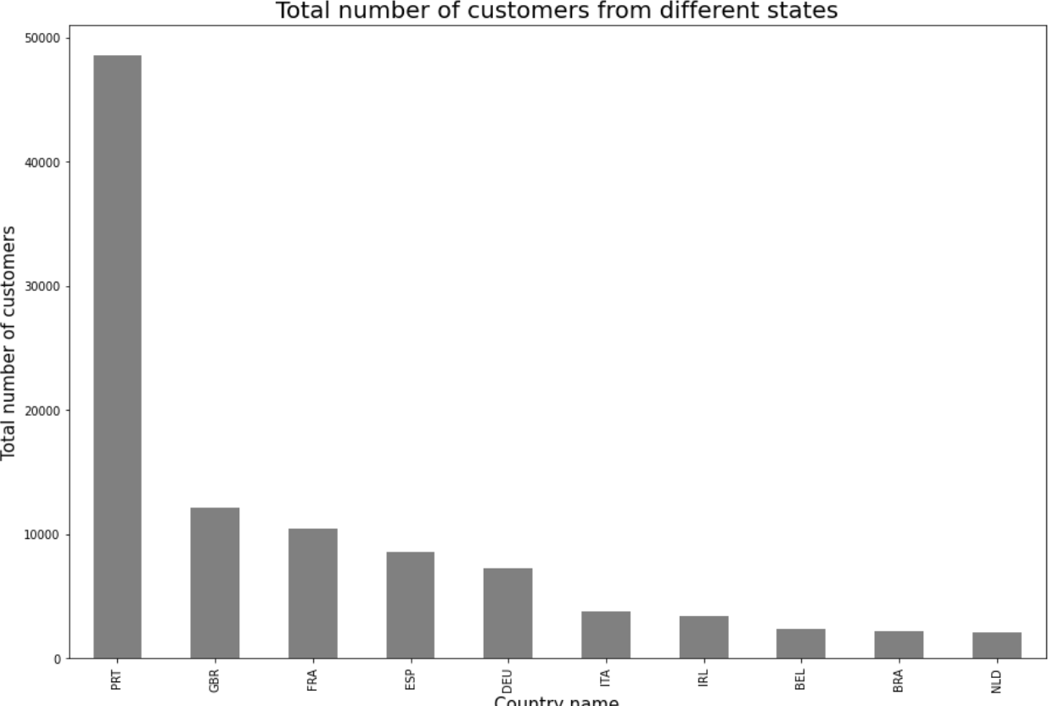
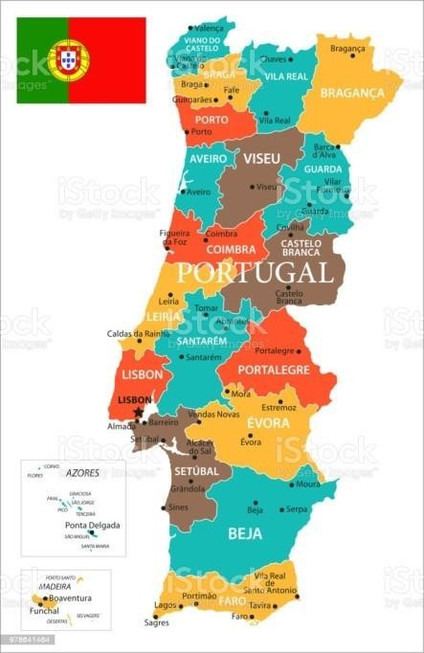
Top 10 Countries with highest number ofBookings

Slide 18
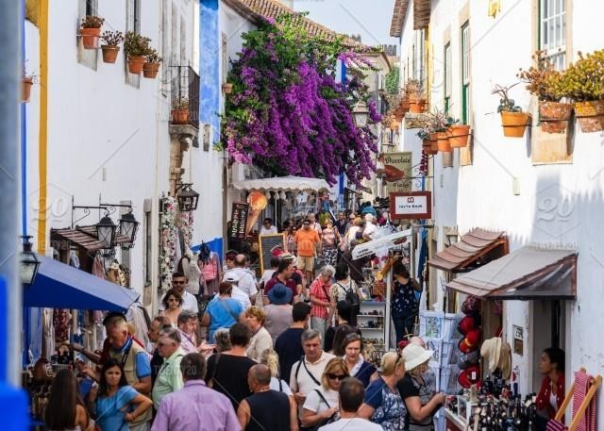
Top 10 Countries with highest number ofBookings
After analyzing the dataset, we found that Portugal tops the position with 48590 customers followed by UK with 12129, France with 10415, Spain with 8568 and Germany with 7287 customers.
Netherlands sits back with least number of customers among the top 10Countries.

Slide 19
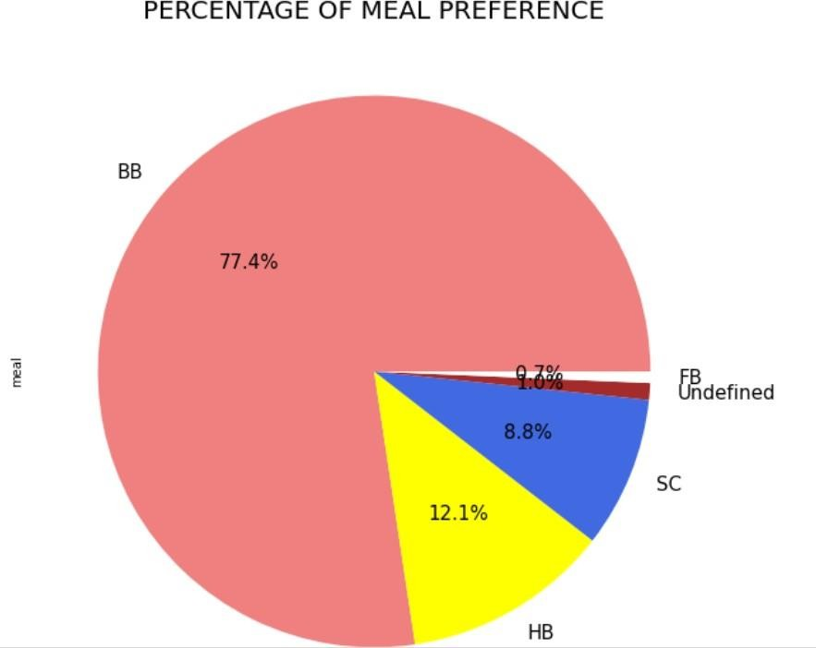
Percentages of Meals Prefered
BB means bed and breakfast.
HB means half board, in which breakfast and dinner are included.
FB means full board, in which breakfast, lunch and dinner are included.
SC meansself-catering (no
meals are included).

Slide 20
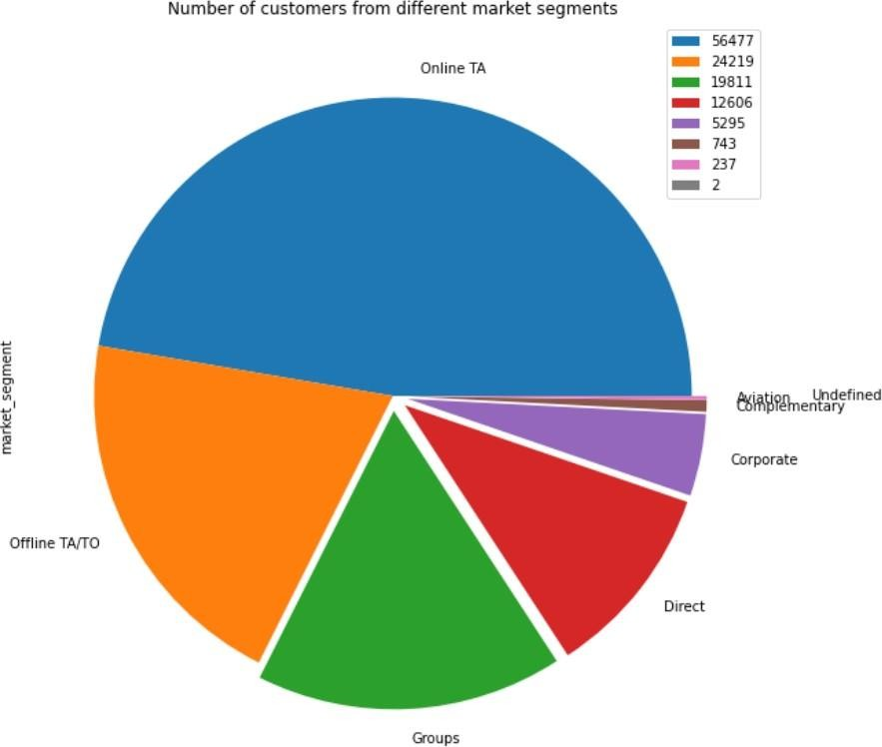
Total Number of Customers across Various Market Segments
Online Travel agency segment gives the high amount of leads for the hotel booking than that of any other sources of Marketsegments.
We can report that we need to target our marketing area on online TA websites or apps and focus majorly on online TA.
The following majority market segments are offline travel agencies, groups and direct customers.

Slide 21
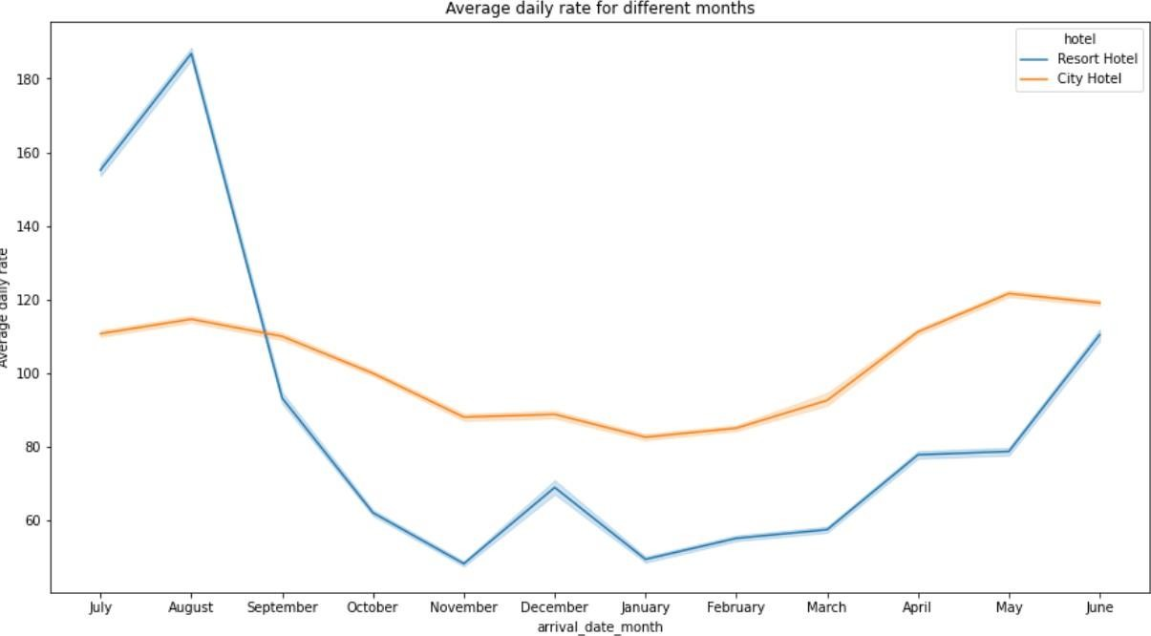
Average Daily Rate for Different Months

Slide 22
Average Daily Rate for Different Months
The average daily rates are high during the months of may, June, July
and august for City hotels.
The average daily rates are high during the months of July, august and
September for Resort Hotels.
Overall ADR for both city and resort hotels are more expensive between may and September.

Slide 23
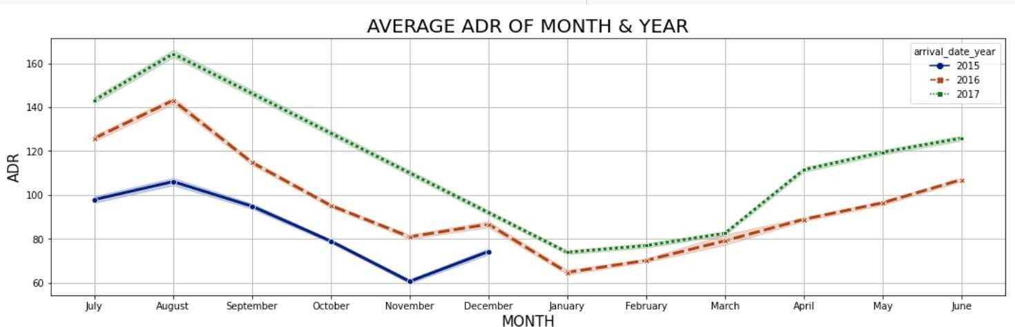
Average Daily Rate for Different Years

Slide 24
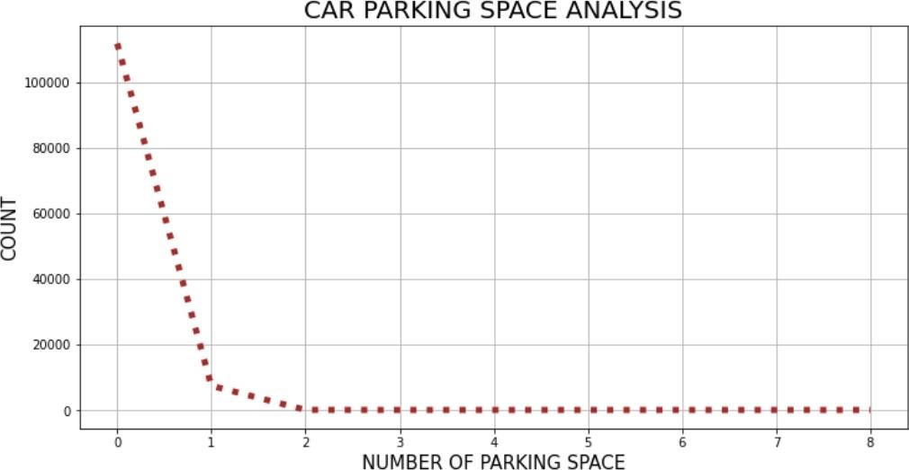
Car Parking space analysis
Most of the hotels have zero car space parking.
Among which have car space parking has one car spacing and the trend decreases drastically as number of car spacing increases.

Slide 25
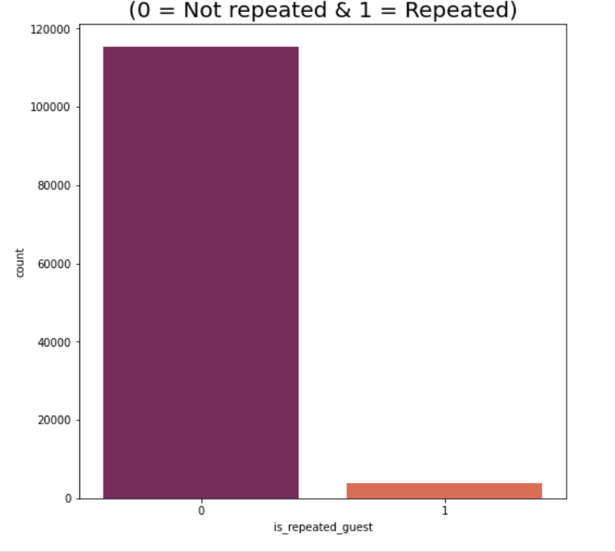
Is- Repeated Guests Counts
Very few number are seem to be
loyal to the hotels.
Only around 3755 bookings are of repeated guests from all the bookings.
The management team has to deal with this by giving discounts for next visit or free coupons or something to increase the number of guests.

Slide 26
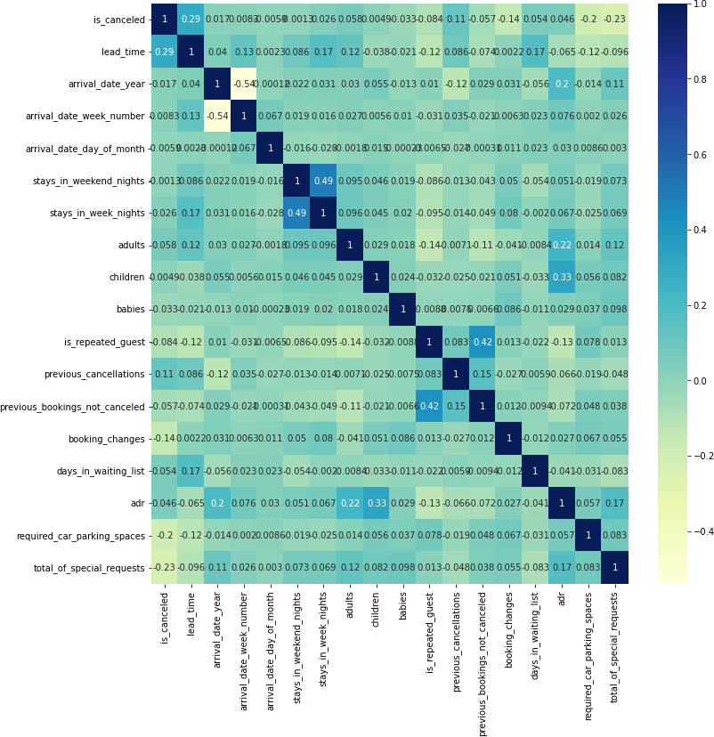
Correlation Heatmap

Slide 27
Conclusion
'City hotels' and 'Resort hotels' are two types of hotels present in the dataset, out of which, 'City hotels’ are more preferred by the customers than the latter. (66.4% customer prefers 'City hotels' whereas 33.6% customerprefers 'Resort hotels’)
Out of 119000 customer dataset, 75166 customers checked in hotel while 44224 customers cancelled their bookings, that is about 37% of the booking got cancelled whereas 63% customers checked in the hotel.
Majority of the deposit type is of 'No deposit' type, which itself concludes the high rate of cancellation rate.
From the given dataset, we can see 2016 is the year in which hotel bookings are the highest.
We can also see the trend in the middle of the year as those season has less weather condition and holidays are more during that season. We can also infer that winter season has the lowest number of bookings around the globe and we can assume it because of the weather condition.
Out of all months, 'August' witnessed highest number of hotel bookings whereas 'January' witnessed the least.
City hotels are of in high demand compared to resort in all aspects due to its reliability of majority of the population.

Slide 28
Conclusion
Most of the customers prefer to stay for one, two and three nights and majority its two and three night which tops.
Among the top 10 countries with respect to number of bookings, most of them are European countries which belongs to the list of which Portugal stands first with 48.5k bookings.
For resort hotels, ADR is more expensive during June, July, August and September whereas for city hotels, ADR is more expensive during May, June July and August. So, Overall ADR of both cities are more expensive between May and September.
Its observed that average ADR is incrementing every year from 2015 to 2017, which clearly states that hotel business is scaling up every year.
Online Travel agencies provides high amount of leads and customers following Offline TA, Groups, Direct, etc., So, we an conclude that we need to focus our marketing area on online TA since majority of the visitors tend to reach out to them.
After analyzing the meal data, its found that 77.3% of customers prefers BB(Bed & Breakfast). 14.Most of the hotels have 0 to 1car parking space.
15. Given that we do not have repeated guests, we should target our advertisement on guests to increase returning guests.

Slide 29
References
https://pandas.pydata.org/
https://matplotlib.org/
https://seaborn.pydata.org/
Geek for geeks

Slide 30
Thank You
Team GodSpeed

